Slide 1
AS91906 (3.7) & AS91907(3.8) Documentation
Conor Smith
Notes:
3.7 AS91906 Programming & 3.8 AS91907

Slide 2
Car Driving Game
Link to GitHub Repository: SmitieC/Assessment: Car Game (github.com)
Links to Trello board / project management tools: Car Game | Trello
Link to final version of your program: Assessment/Fully working game.py at main · SmitieC/Assessment (github.com)

Slide 3
Relevant Implications: Functionality
Functionality involves ensuring that the car game works as expected. It should work for everyone who tries to use it. Once all non-core libraries are installed the code should fully function with everything attached in the GitHub repository
Functionality matters because if a program does crash or does not work as expected, users will become frustrated. Programs that don't work correctly are of limited use and in real life, if a program does not function It could cause users harm and/or damage the reputation of the developer.
Notes:
Additional rows can be added by clicking in the last cell and then using the Tab key

Slide 4
Relevant Implications: Usability
Usability involves making it possible for people to use a program without needing to ask for help. For my Car game, this would mean that the user can easily figure out the controls, and redundant keys play no part in the game until needed. My aim is to make the program less frustrating to use. Usability is about how easily the end user can accomplish tasks. It deals with issues like making instructions and error messages clear and easy for users to understand.
Usability matters because if a program is hard to use people will get frustrated and give up. This could result in the program not being used/bought and so the developer would lose money. The consequences of poor usability are very similar to those of poor functionality.
Notes:
Additional rows can be added by clicking in the last cell and then using the Tab key

Slide 5
Relevant Implications: Aesthetics
Aesthetics Involves an outcome's overall appearance. A program which is well designed, colorful and looks aesthetically pleasing to the user
Aesthetics matters because users prefer games which are attractive over those that are plain and boring. To achieve this my code will have lots of colorful moving parts that capture my user's attention while also being simplistic so that the user does not get overwhelmed.
Notes:
Additional rows can be added by clicking in the last cell and then using the Tab key

Slide 6
Relevant Implications: Social
The social implications of an outcome involve how it affects users, the wider community and society as a whole. For example, car crashes are uncomfortable topic for some, based on their personal experiences or others around them. These social implications matter because If they are not considered and addressed, an outcome could have unintended consequences.
In the case of the car game, It is hoped that the game will suit everyone, because the end product should be fun and enjoyable for all. It Is Important that the interface has language appropriate and comprehensible to the community I will be targeting. I have opted for relaxed unformal language in the wording of my game over messages, making the outcome suitable for our intended audience (users aged 10 and up). The language is easy to understand. It is important to that although the program is about car crashes that I do not have anything that could inflict painful memories to anyone that plays the game. For example, loud noises or graphics relating to the crash.
Notes:
Additional rows can be added by clicking in the last cell and then using the Tab key

Slide 7
Graphical User Interface - design:
Create wireframes for your program’s GUI. Please place them on this slide.
Notes:
Create wireframes for your program’s GUI. Please place them on this slide.

Slide 8
Program Structure:
Create a diagram showing your program’s structure and outline the classes and functions that you plan on developing. You are welcome to edit this slide once you start developing the outcome BUT when you do that, you should show what has changed and explain why those changes were needed.
Driver Class
Obstacle Class
Game Loop Function
Notes:
Create a diagram showing your program’s structure and outline the classes and functions that you plan on developing. You are welcome to edit this slide once you start developing the outcome BUT when you do that, you should show what has changed and explain why those changes were needed.

Slide 9
Program Structure Edited:
I edited my program structure by putting all the class and functions into one loop and at the end of the call calling this function. I did this so that I could create an endless cycle of the game being played and if the user dies it calls the restart function that can then call the whole game loop and restart the game.
This makes it easier to reanimate all the involved sprites and reset all the necessary variables.
It will now do this loop until the player decides to quit either by clicking the x button on the window or pressing q when prompted by the game over screen
Game Loop Function
Driver Class
Obstacle Class
Game Running While Loop
Game over function
Notes:
Create a diagram showing your program’s structure and outline the classes and functions that you plan on developing. You are welcome to edit this slide once you start developing the outcome BUT when you do that, you should show what has changed and explain why those changes were needed.

Slide 10
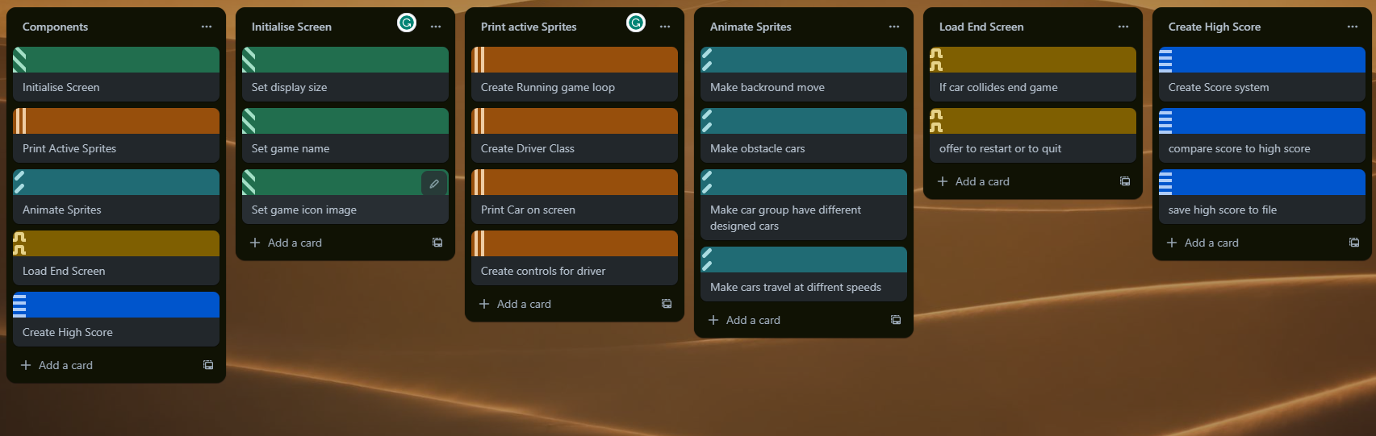
Problem Decomposition:
Provide evidence showing that you have decomposed the task. This can be in the form of a trello screenshot or a list of components. If necessary, you may revisit this slide and add to it or edit it as you create your outcome. When you make changes to this slide, please date the changes and explain why they were made (this can help provide evidence for M / E grades).
Hint: Use the structure you developed earlier to work out what components you need. For each function, you should have at least one component.
Task Components
Put
Components
here
Notes:
Provide evidence showing that you have decomposed the task. This can be in the form of a trello screenshot or a list of components. If necessary, you may revisit this slide and add to it / edit it as you create your outcome. When you make changes to this slide, please do so in a different colour, date the changes and explain why they were made (this can help provide evidence for M / E grades).
Hint: Use the structure you developed earlier to work out what components you need. For each function, you should have at least one component.
Task Components
Put
Components
here

Slide 11
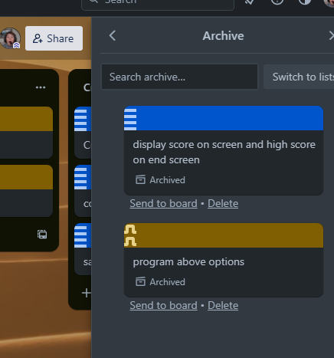
Problem Decomposition Edited:
I made two changes from my original decomposition.
Firstly, I combined “display score on screen and high score on end screen” into their respective components. I did this because it made it easier and more functional while I tested and trialled the creation of the components, to get real time feedback for each iteration.
Secondly, I combined “program above options” referring to restart or quit. I did this because when trying to get my program to restart I was running into issues because I had not yet programmed the user getting the options. This made my code work more seamlessly helping with my relevant implications
Notes:
Provide evidence showing that you have decomposed the task. This can be in the form of a trello screenshot or a list of components. If necessary, you may revisit this slide and add to it / edit it as you create your outcome. When you make changes to this slide, please do so in a different colour, date the changes and explain why they were made (this can help provide evidence for M / E grades).
Hint: Use the structure you developed earlier to work out what components you need. For each function, you should have at least one component.
Task Components
Put
Components
here

Slide 12
Component development:
Make as many copies of the next three slides as you need. For each component you should have…
A Trello screenshot / evidence of ongoing use of your project management tools
A test plan for the component that has been created BEFORE you start coding. Your plan should allow you to test all logical pathways for this component. It should also include test cases for relevant boundary and unexpected values.
Screenshot evidence showing that you have worked through the test plan you developed.
You should also provide evidence of trialling multiple components & techniques. Please make slides as needed for that evidence.
Notes:
Make as many copies of the next three slides as you need. For each component you should have…
A Trello screenshot / evidence of ongoing use of your project management tools
A test plan for the component that has been created BEFORE you start coding. Your plan should allow you to test all logical pathways for this component. It should also include test cases for relevant boundary and unexpected values.
Screenshot evidence showing that you have worked through the test plan you developed.
You should also provide evidence of trialling multiple components & techniques. Please make slides as needed for that evidence.

Slide 13
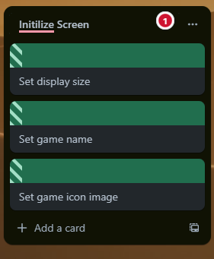
1 Component Planning: COMPONENT 1 Initialize Screen
How might your component work. This could be in the form of a Trello screenshot.
Notes:
Duplicate this slide and use it to show your planning for the current component. This could be in the form of a Trello screenshot.

Slide 14
2 Component Test Plan: COMPONENT 1 Initialize Screen
Create a test plan for this component BEFORE you start coding. Your plan should allow you to test all logical pathways for this component. It should also include test cases for relevant boundary and unexpected values.
Test Cases - input | Expected output
Program started | Blank window generated 700 x 925 pixels, Lasts for 5 seconds
Program started | Window name = “Car driving Game”
Program started | Game icon = provided image
Notes:
Create a test plan for this component BEFORE you start coding. Your plan should allow you to test all logical pathways for this component. It should also include test cases for relevant boundary and unexpected values.

Slide 15
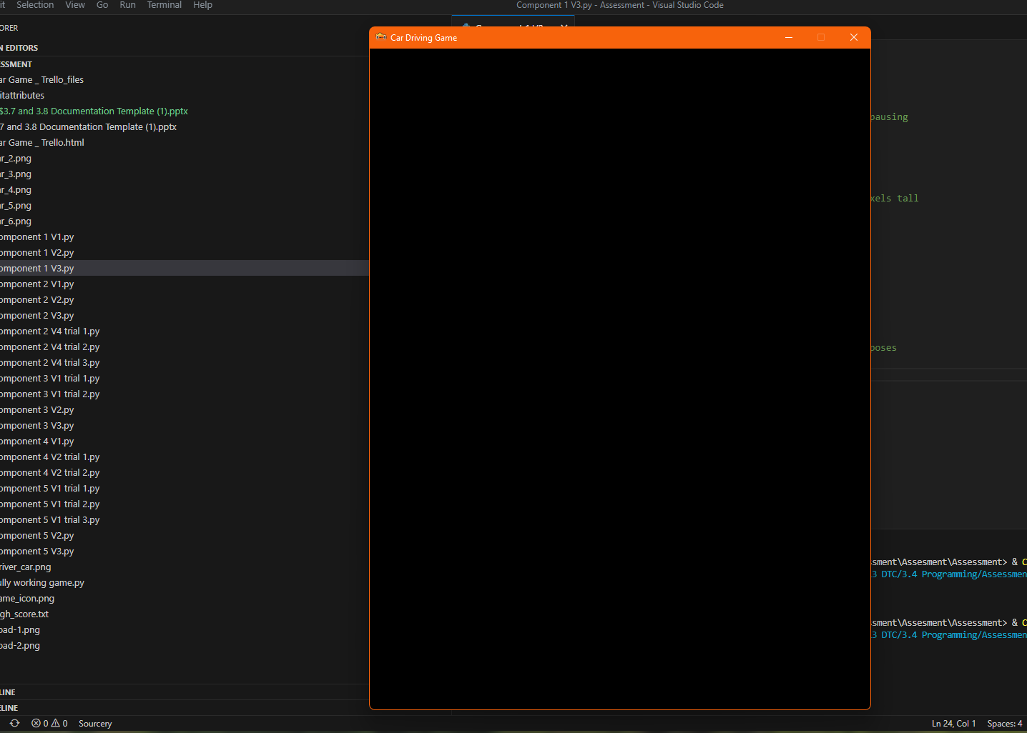


3 Evidence of testing: COMPONENT 1 Initialize Screen
Use this slide to provide evidence that you have tested your component in accordance with the test plan you developed earlier.
Window icon is set to be provided recourse
Window title = “Car Driving Game”
Window 700 x 925 generated
Notes:
Use this slide to provide evidence that you have tested your component in accordance with the test plan you developed earlier.

Slide 16
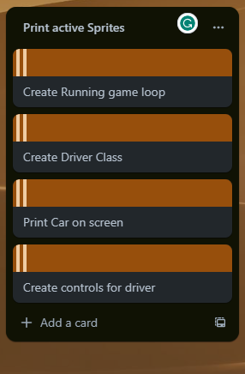
1 Component Planning: COMPONENT 2 Print active Sprites
How might your component work. This could be in the form of a Trello screenshot.
Notes:
Duplicate this slide and use it to show your planning for the current component. This could be in the form of a Trello screenshot.

Slide 17
2 Component Test Plan: COMPONENT 2 Print active Sprites
Create a test plan for this component BEFORE you start coding. Your plan should allow you to test all logical pathways for this component. It should also include test cases for relevant boundary and unexpected values.
Test Cases - input | Expected output
Program started | White background and red driver car
Left arrow pressed | Car tilts left and moves left
Right arrow pressed | Car tilts right and moves right
Both arrow pressed | Car does not move and faces forewords
Nothing pressed | Car does not move and faces forewords
Notes:
Create a test plan for this component BEFORE you start coding. Your plan should allow you to test all logical pathways for this component. It should also include test cases for relevant boundary and unexpected values.

Slide 18
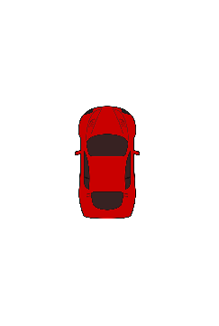
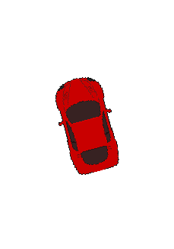
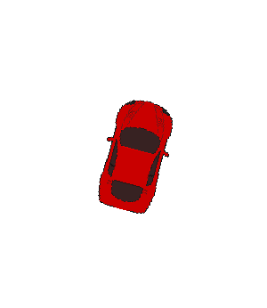
3 Evidence of testing: COMPONENT 2 Print active Sprites
Use this slide to provide evidence that you have tested your component in accordance with the test plan you developed earlier.
Car appears and background is white
Car is tilted right and is moving right
Car is tilted left and is moving left
Notes:
Use this slide to provide evidence that you have tested your component in accordance with the test plan you developed earlier.

Slide 19
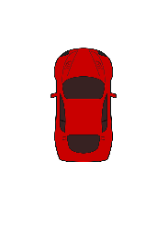
3.5 Evidence of testing: COMPONENT 2 Print active Sprites
Car is stationary and is facing upwards
Car is stationary and is facing upwards
Notes:
Use this slide to provide evidence that you have tested your component in accordance with the test plan you developed earlier.

Slide 20
4 Discussion: COMPONENT 2 Print active Sprites
When Choosing Sprites for my game I had to consider publicity, appropriability and practicality
For this component I had to use a car to be my driver car. I used a red car given to me from the assessment recourses this way I was sure that the car was fit for purpose for this game.
Notes:
Use this slide to provide evidence that you have tested your component in accordance with the test plan you developed earlier.

Slide 21
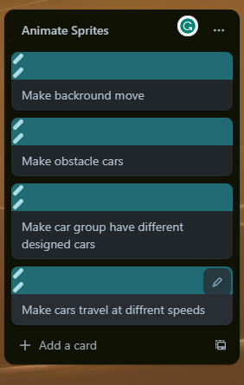
1 Component Planning: COMPONENT 3 Animate Sprites
How might your component work. This could be in the form of a Trello screenshot.
Notes:
Duplicate this slide and use it to show your planning for the current component. This could be in the form of a Trello screenshot.

Slide 22
2 Component Test Plan: COMPONENT 3 Animate Sprites
Create a test plan for this component BEFORE you start coding. Your plan should allow you to test all logical pathways for this component. It should also include test cases for relevant boundary and unexpected values.
Test Cases - input | Expected output
Program started | Road background
Program started | Obstacles generated randomly
Program started | Obstacles are randomly coloured
Program started | Obstacles travel at different speeds
Notes:
Create a test plan for this component BEFORE you start coding. Your plan should allow you to test all logical pathways for this component. It should also include test cases for relevant boundary and unexpected values.

Slide 23
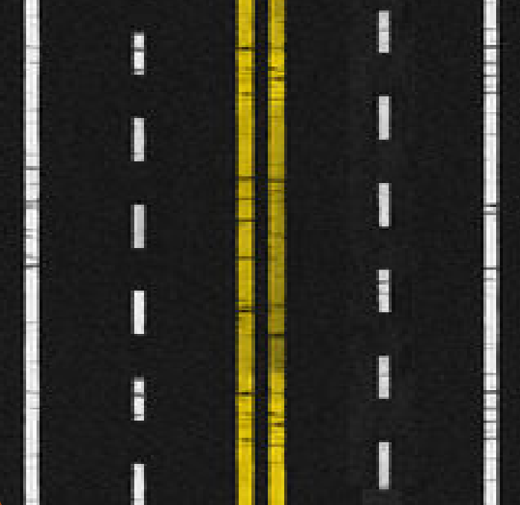
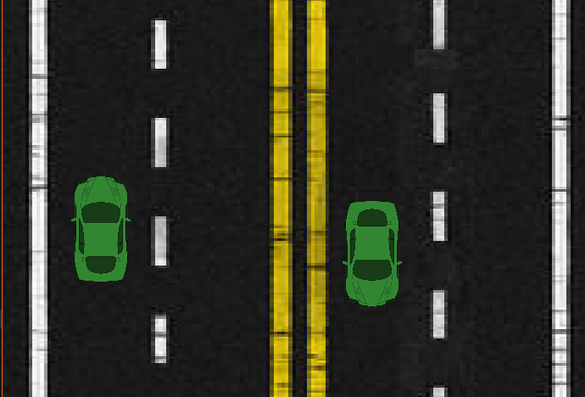
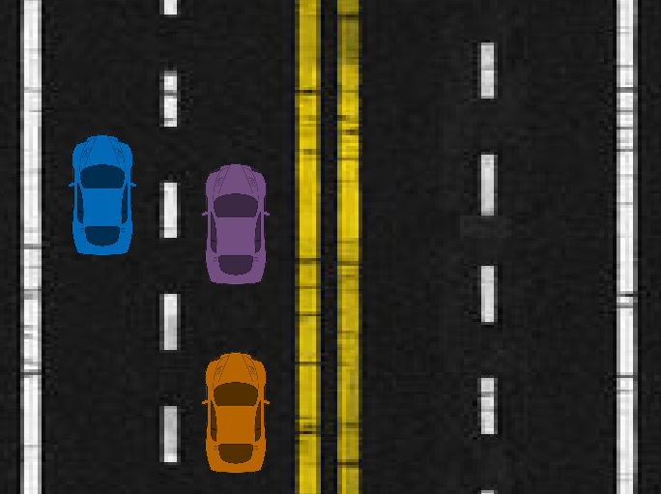
3 Evidence of testing: COMPONENT 3 Animate Sprites
Use this slide to provide evidence that you have tested your component in accordance with the test plan you developed earlier.
Cars spawning successfully
Background loaded successfully
Cars are random colour
Notes:
Use this slide to provide evidence that you have tested your component in accordance with the test plan you developed earlier.

Slide 24
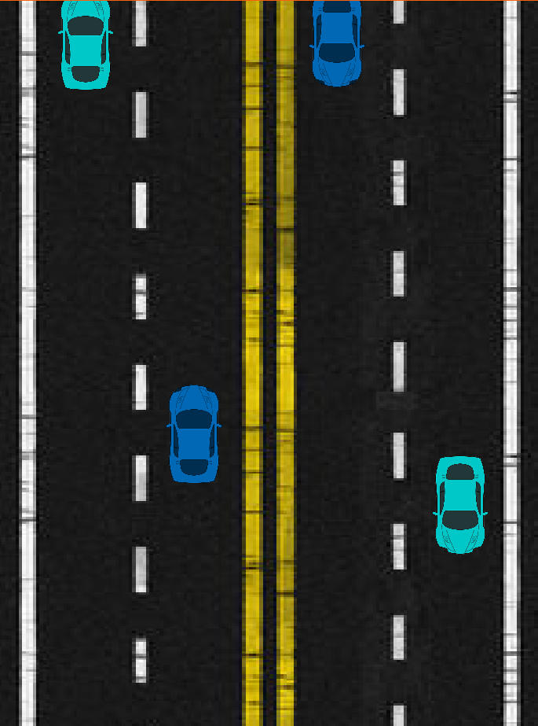
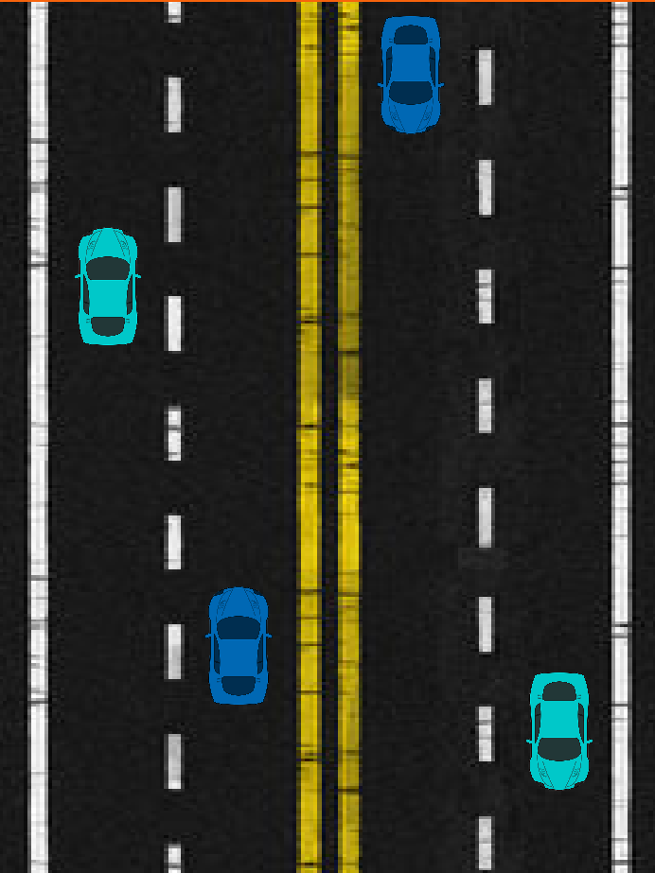
3.5 Evidence of testing: COMPONENT 3 Animate Sprites
Frame 1
Frame 2
Cars are now traveling at diffrent rates across the screen
As shown by comparison of frame 1 compared to frame 2
Notes:
Use this slide to provide evidence that you have tested your component in accordance with the test plan you developed earlier.

Slide 25
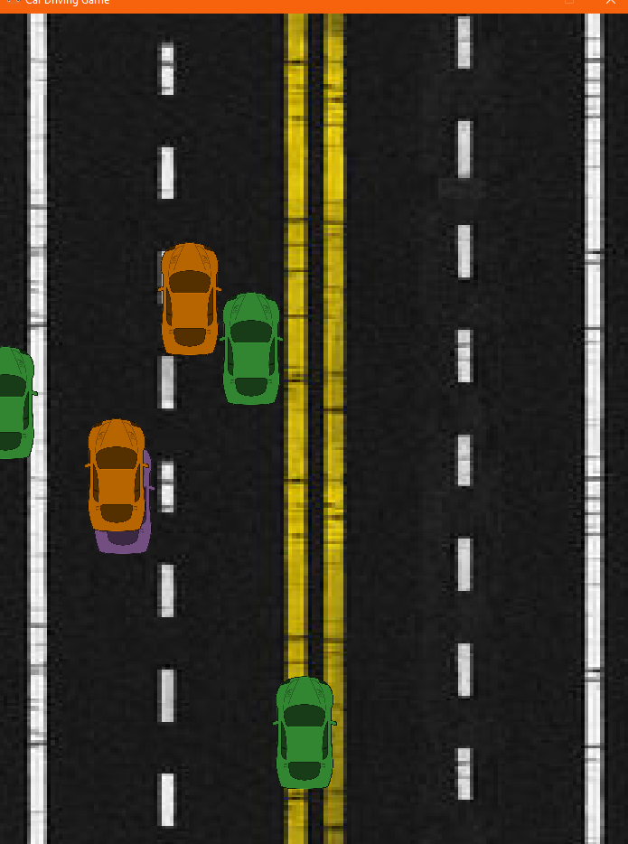
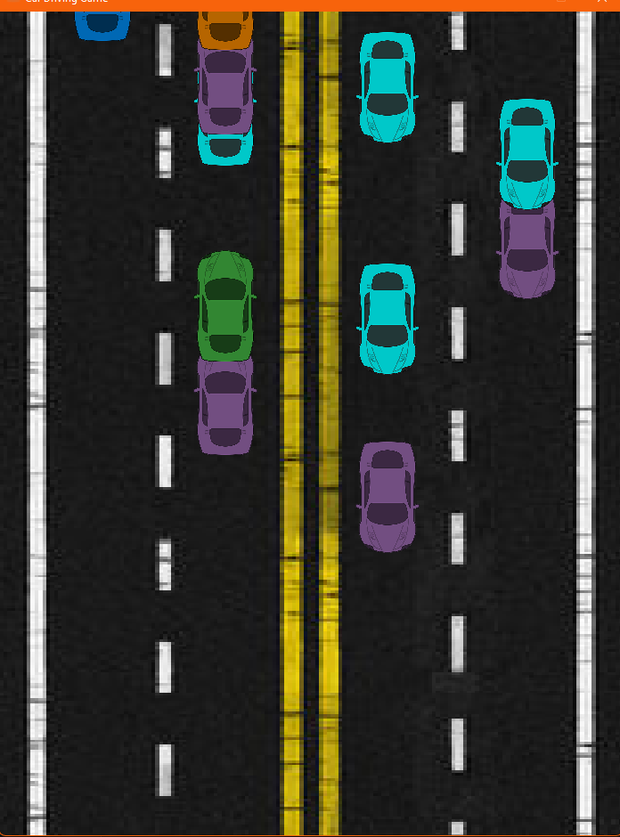
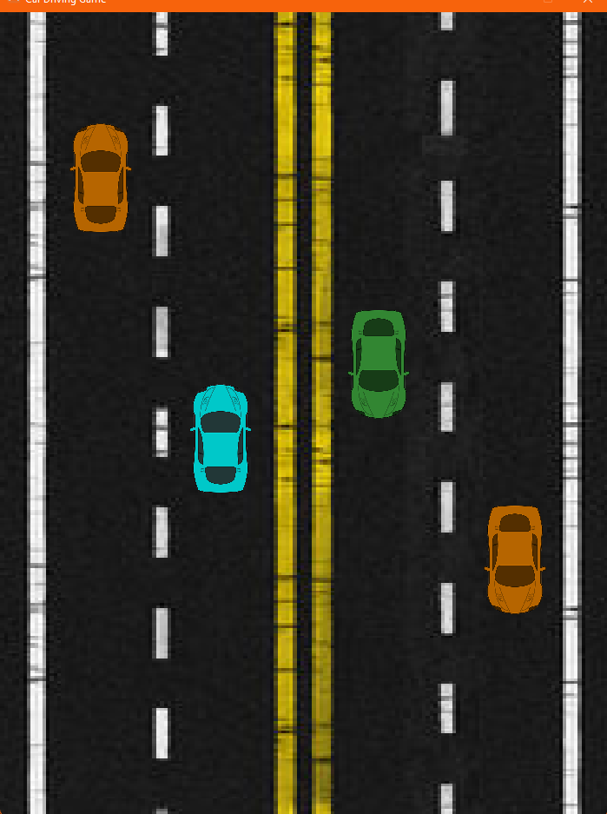
4 Trialling: COMPONENT 3 Animate Sprites
1.
Trial 1. When picking what x value an obstacle is going to have, I firstly had it set to a random value anywhere across the screen. But from my perspective this didn’t quite look right as I had obstacles in road markings and also partially over top each other.
Trial 2. I trialled a different way of doing this by then picking a random lane for each obstacle to drive down from. This resulted in the obstacles sticking to their respective lanes but now they were driving on top of each other which still did not look right
Trial 3. My final trial I ended up blocking any attempt to spawn an obstacle if one was already in that lane. This resulted in a product I am happy with where obstacles are driving in their lanes and do not drive over top of each other I also set a max number of cars trying to spawn at 4 so that it would only attempt to spawn one when a lane is free
My final result will impact the overall usability of my game as it will make the game easier to dodge and predict where cars will come from, I am however, happy with the final result and how it address’ my relevant implications.
2.
3.
Notes:
Use this slide to provide evidence that you have tested your component in accordance with the test plan you developed earlier.

Slide 26
5 Discussion: COMPONENT 3 Animate Sprites
When developing my road my first iteration had just the image as the background, this didn’t fit the aesthetic of the game and so I edited to move seamlessly this is much more appealing and makes the whole rest of the game look better.
When picking out an image to use as my road I had to ensure that it was appropriate, functional and Non-copyright. The one I have chosen fits within these guidelines and so to ensure I address all relevant implications.
I also used images for my obstacle's cars, these were provided from the assessment recources and so also do comply.
Notes:
Use this slide to provide evidence that you have tested your component in accordance with the test plan you developed earlier.

Slide 27
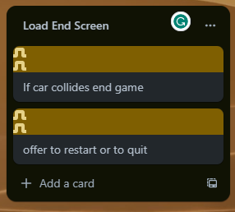
1 Component Planning: COMPONENT 4 Load End Screen
How might your component work. This could be in the form of a Trello screenshot.
Notes:
Duplicate this slide and use it to show your planning for the current component. This could be in the form of a Trello screenshot.

Slide 28
2 Component Test Plan: COMPONENT 4 Load End Screen
Create a test plan for this component BEFORE you start coding. Your plan should allow you to test all logical pathways for this component. It should also include test cases for relevant boundary and unexpected values.
Test Cases - input | Expected output
Driver collides with Obstacle | Show end game screen
End game screen, “r” pressed | Game restarts
End game screen, “q” pressed | Program exits
Notes:
Create a test plan for this component BEFORE you start coding. Your plan should allow you to test all logical pathways for this component. It should also include test cases for relevant boundary and unexpected values.

Slide 29
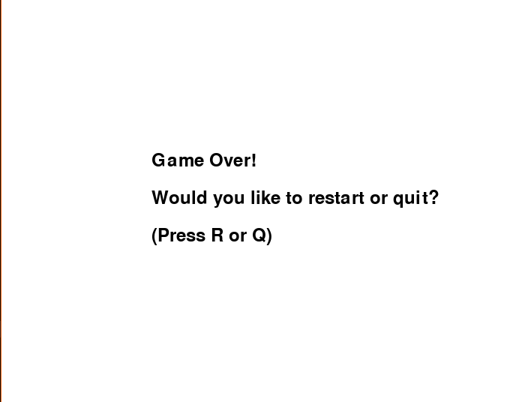
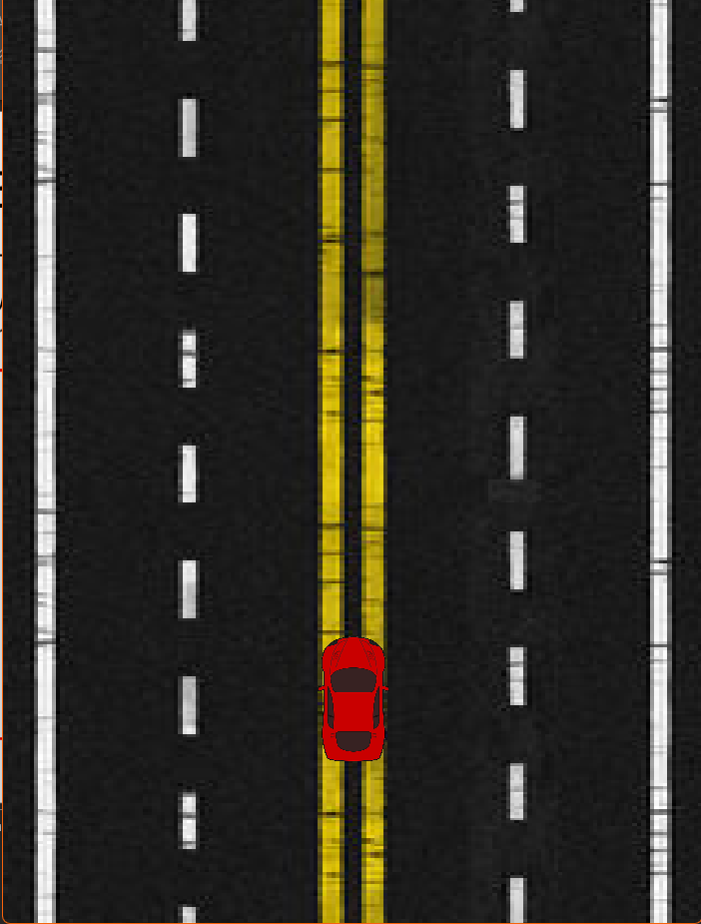
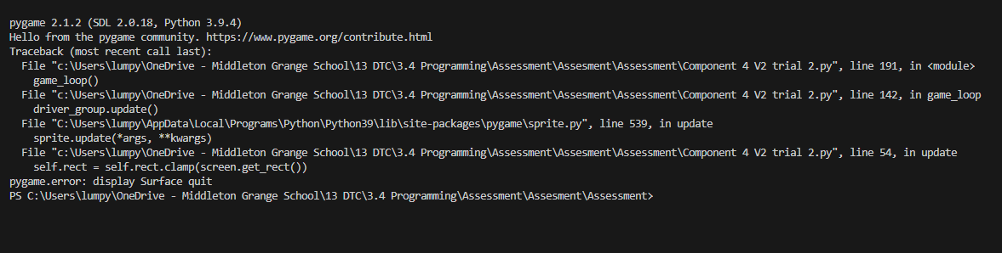
3 Evidence of testing: COMPONENT 4 Load End Screen
Use this slide to provide evidence that you have tested your component in accordance with the test plan you developed earlier.
When collision was made the end screen loaded correctly
“q” pressed window was quit. (screenshot of terminal closing window)
“r” pressed; game restarted
Notes:
Use this slide to provide evidence that you have tested your component in accordance with the test plan you developed earlier.

Slide 30
4 Discussion: COMPONENT 4 Load End Screen
When attempting to get my restart function to work I went through some diffrent iterations, firstly trying to call the while loop back. This didn’t work because my original code relied on the variable game_over to be false. This meant I would have to change my while loop. After changing that the restart option would only work one time. As a result of this I made this into a function and moved the whole rest of my code into a function (game_loop) this worked for my code and was a change from my original program structure.
Notes:
Use this slide to provide evidence that you have tested your component in accordance with the test plan you developed earlier.

Slide 31
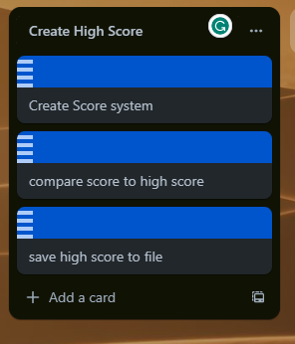
1 Component Planning: COMPONENT 5 Create High Score
How might your component work. This could be in the form of a Trello screenshot.
Notes:
Duplicate this slide and use it to show your planning for the current component. This could be in the form of a Trello screenshot.

Slide 32
2 Component Test Plan: COMPONENT 5 Create High Score
Create a test plan for this component BEFORE you start coding. Your plan should allow you to test all logical pathways for this component. It should also include test cases for relevant boundary and unexpected values.
Test Cases - input | Expected output
No high score (HS) set | HS = 0 (write output = 0)
HS = 1 Score > 1 | HS = Score (write output = score)
HS = 10 Score <10 | HS = 10 (no write output)
HS = 0 Score = 0 | HS = 0 (no write output)
“Hello!” (str) | HS= 0 (write output = 0)
Notes:
Create a test plan for this component BEFORE you start coding. Your plan should allow you to test all logical pathways for this component. It should also include test cases for relevant boundary and unexpected values.

Slide 33
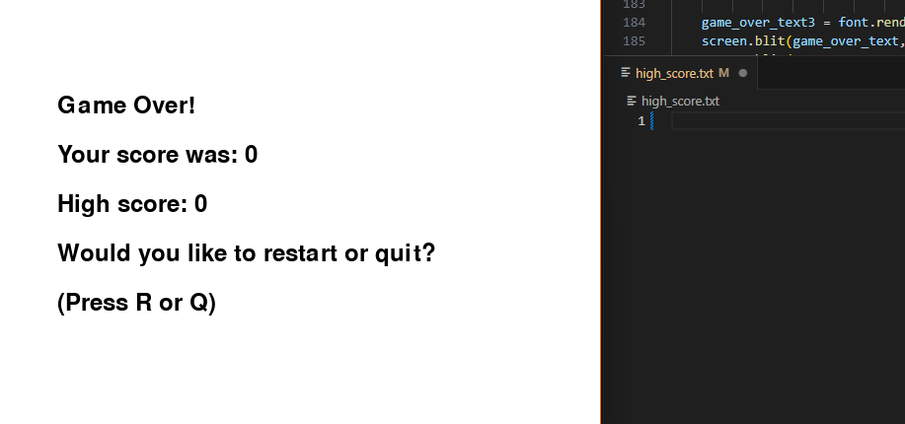
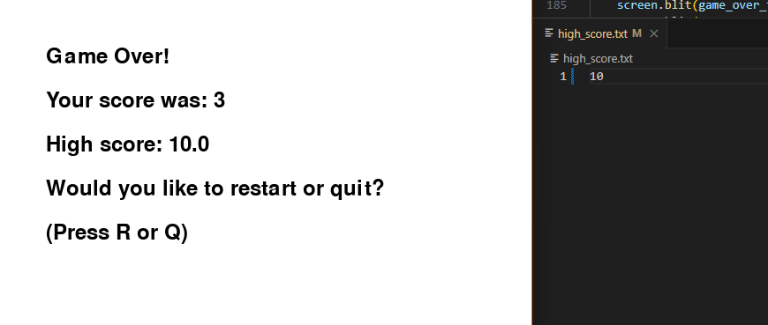
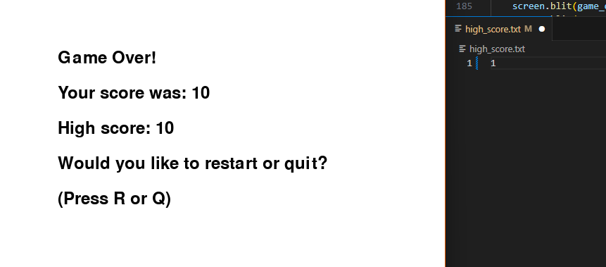
3 Evidence of testing: COMPONENT 5 Create High Score
Use this slide to provide evidence that you have tested your component in accordance with the test plan you developed earlier.
Empty File was updated to 0
(working as expected)
High Score was not updated
(working as expected)
High score was updated to 10
(working as expected)
Notes:
Use this slide to provide evidence that you have tested your component in accordance with the test plan you developed earlier.

Slide 34
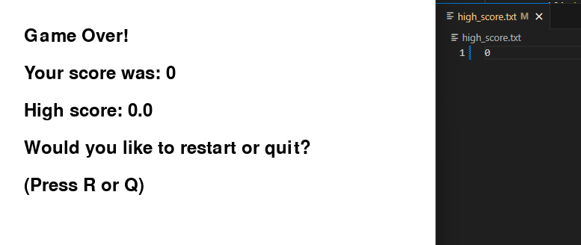
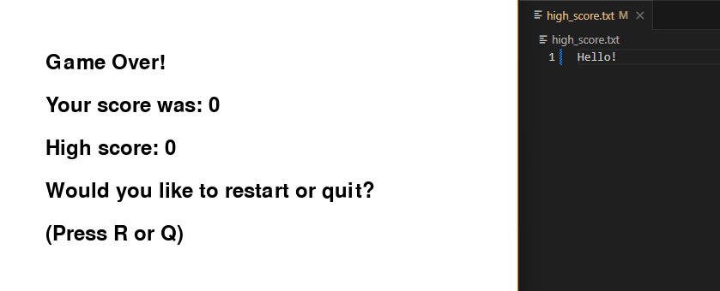
3.5 Evidence of testing: COMPONENT 5 Create High Score
High Score was not updated
(working as expected)
High Score was not updated
(working as expected)
Notes:
Use this slide to provide evidence that you have tested your component in accordance with the test plan you developed earlier.

Slide 35
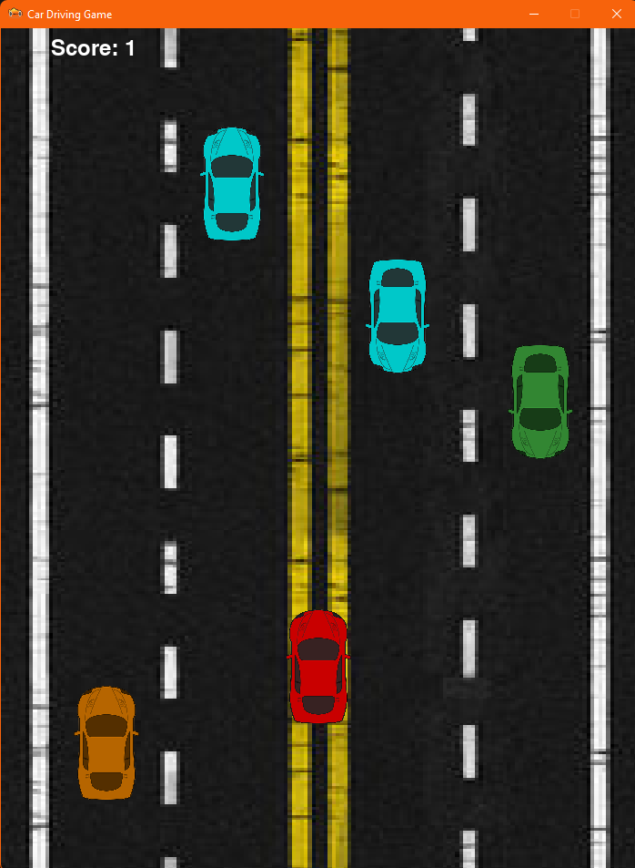
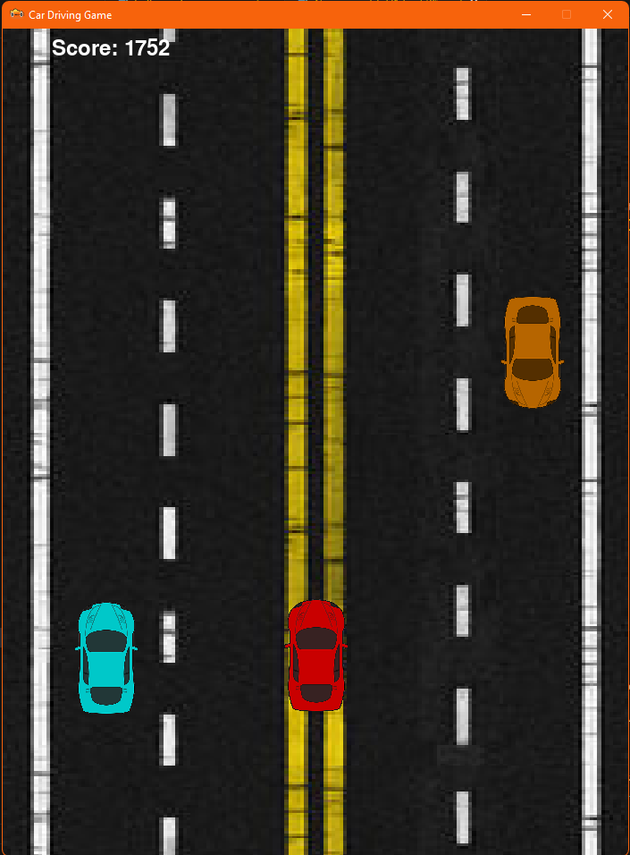
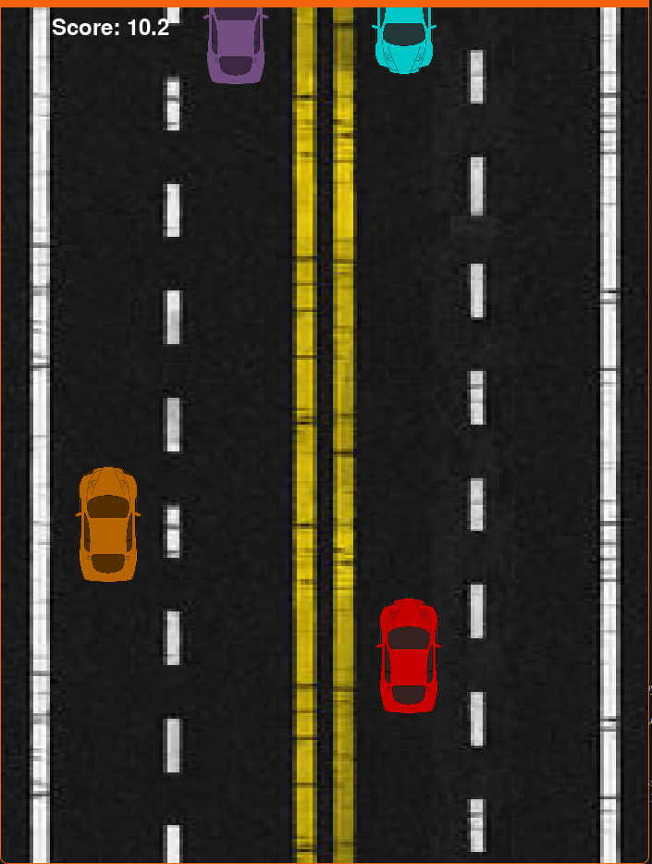
4 Trialling: COMPONENT 3 Animate Sprites
1.
Screenshot shows score added by 1 once a obstacle is passed
Trial 1. When deciding how to score the game I trialled different ways to do it. My first way to calculate score was by each obstacle the driver passed. I did this by checking for obstacle position and if it was greater than drivers position then it would add score by one. I then had to make sure it would only add one score per car forever, so I set a true false value prohibiting anymore contribution to score.
Trial 2. My second trial I wanted to try set score based on distance travelled. I did this by adding the same value that my road moved to my score. This resulted in much bigger scores then previously and I was not as happy with this outcome
Trial 3. On my third Trial I wanted to set score based on time. My first attempt resulted in the score adding 1 per second. To me this felt slow as the score was very rarely getting updated. I changed this to add 0.1 every millisecond this meant that the player would feel like they are accomplishing more in the moment being able to see the score tick up more frequently.
For my final result I went with cars passed. I did this because it felt for natural and initiative for the player. I consulted others like my dad to play test it and he tried all three and agreed the past cars scoring was the best suited for my game style. I also changed the read to instead be a integer rather than a float so that the end screen looks cleaner.
2.
3.
Notes:
Use this slide to provide evidence that you have tested your component in accordance with the test plan you developed earlier.

Slide 36
Assembled Outcome Testing:
Assemble your components into a working program. On the slides that follow, please provide a test plan and evidence that your program works as expected.
If you are going for M / E, you also need to create extra slides showing how you have used your testing to improve the functionality of your program. This could mean having multiple test plans (and screenshots) showing several iterations of the assembled program.
Notes:
Assemble your components into a working program. On the slides that follow, please provide a test plan and evidence that your program works as expected.
If you are going for M / E, you also need to create extra slides showing how you have used your testing to improve the functionality of your program. This could mean having multiple test plans (and screenshots) showing several iterations of the assembled program.

Slide 37
1 Assembled Outcome Testing – Test Plan
Test Cases - input | Expected output
Program started | red driver car with road background moving
Left arrow pressed | Car tilts left and moves left
Right arrow pressed | Car tilts right and moves right
Both arrow pressed | Car does not move and faces forewords
Nothing pressed | Car does not move and faces forewords
Driver Hits Obstacle | Game Over, End Screen
(When Dead) “r” pressed | Program Restarts
(When Dead) “q” pressed | Program Exits
(Score) Score > HS | HS is updated
(Score) Score = HS | HS is not updated
(Score) Score < HS | HS is not updated
Notes:
Use this slide to provide a test plan for your complete program. You may wish to create multiple slides so that you can test for expected, boundary and unexpected cases.
Remember to test ALL logical pathways so that you can ensure your program works correctly.

Slide 38
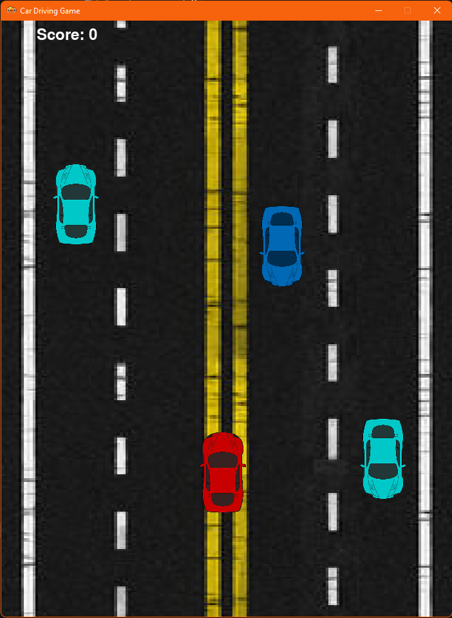
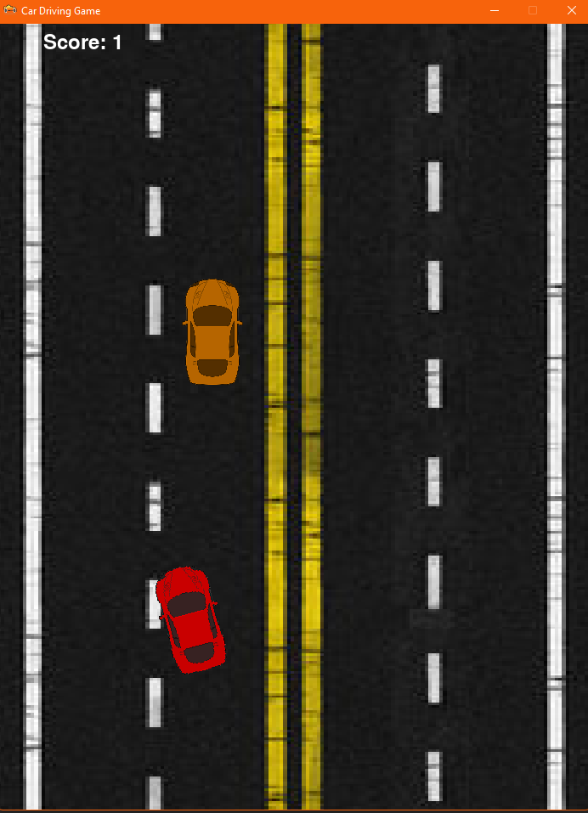
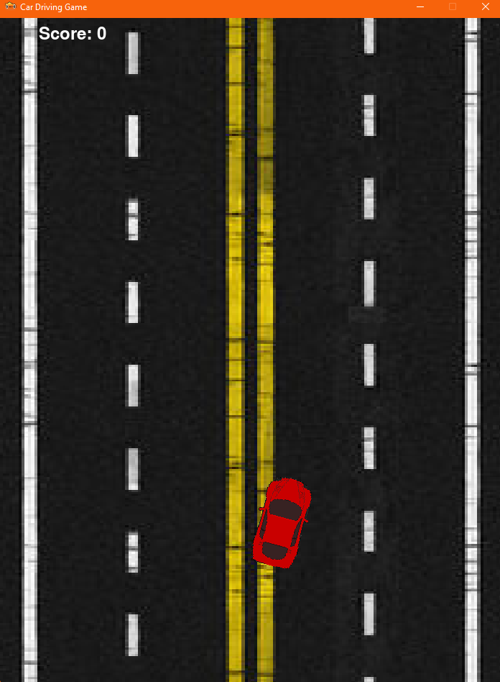
2 Assembled Outcome Testing - Evidence
Create as many slides as needed to provide evidence of testing that your outcome works for expected, boundary and unexpected cases.
Game Opens and starts as intended
Right arrow key pressed, car tilts and moves right
Left arrow key pressed, car tilts and moves left
Works as intended
Works as intended
Works as intended
Notes:
Create as many slides as needed to provide evidence of testing that your outcome works for expected, boundary and unexpected cases.

Slide 39
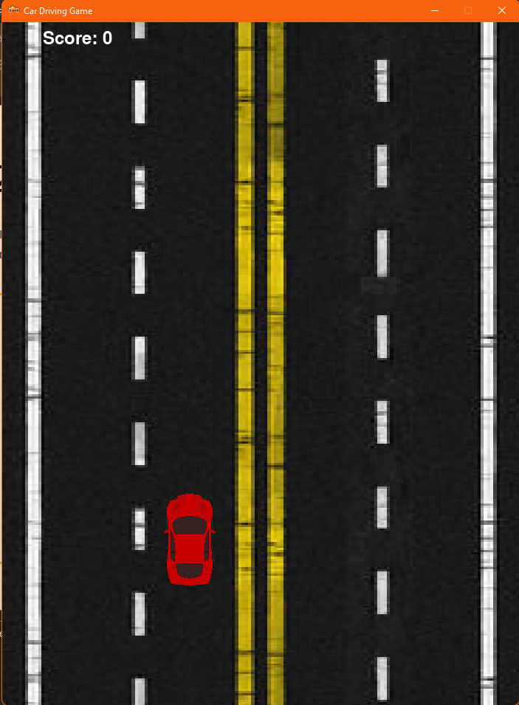
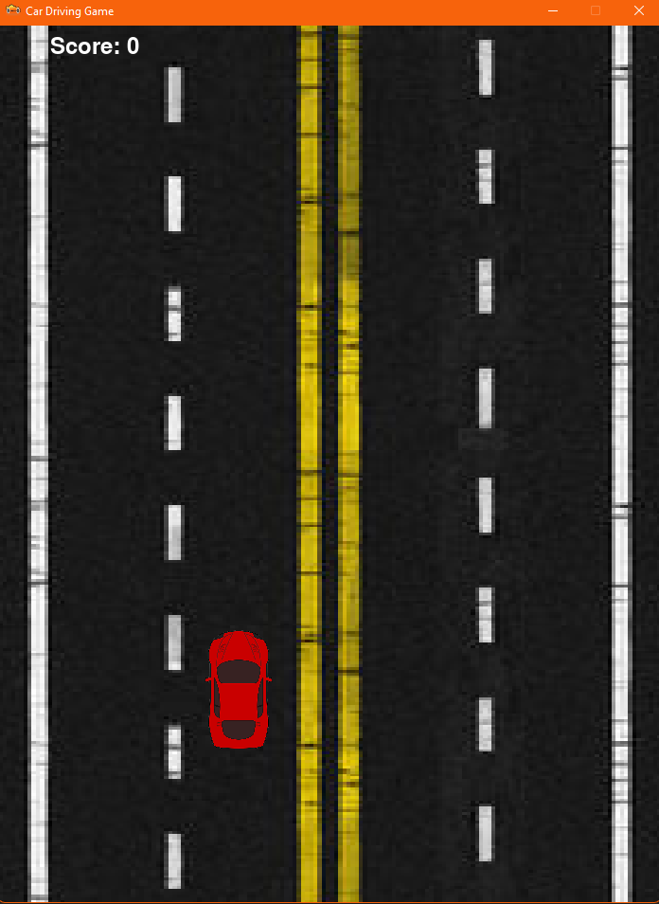
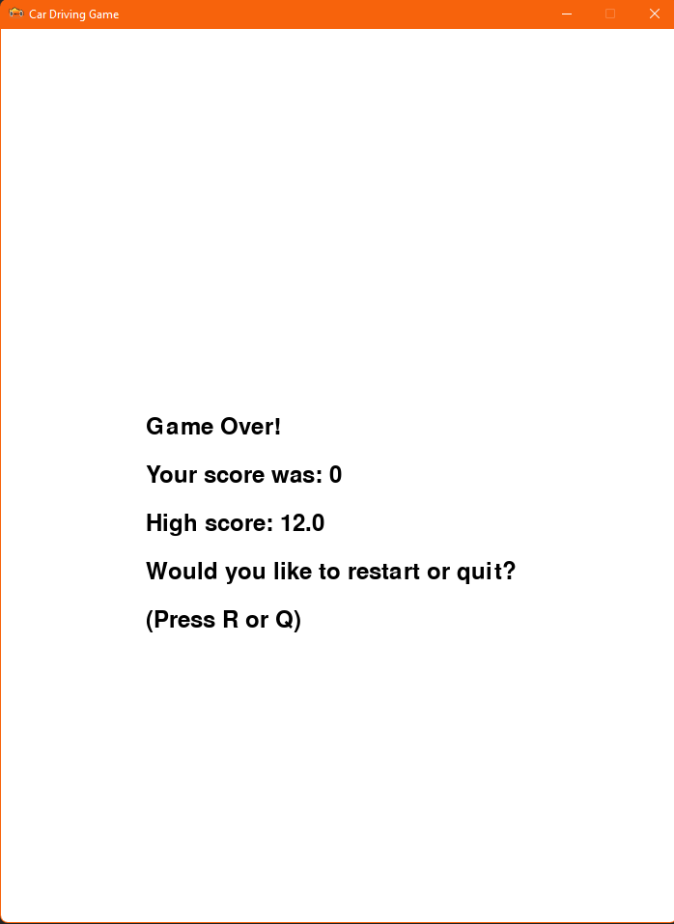
2.1 Assembled Outcome Testing - Evidence
Create as many slides as needed to provide evidence of testing that your outcome works for expected, boundary and unexpected cases.
Both arrow keys pressed, car does not move and no tilt
Driver Car collides with obstacle, End screen shows
No arrow keys pressed, car does not move and no tilt
Works as intended
Works as intended
Works as intended
Notes:
Create as many slides as needed to provide evidence of testing that your outcome works for expected, boundary and unexpected cases.

Slide 40
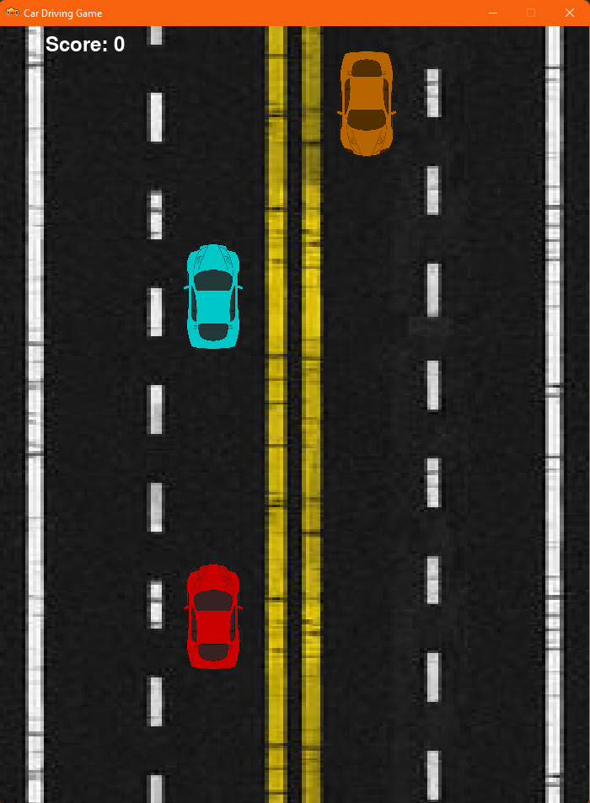
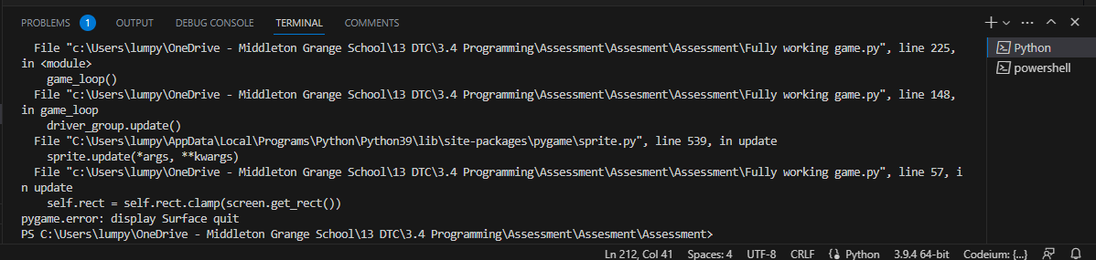
2.2 Assembled Outcome Testing - Evidence
Create as many slides as needed to provide evidence of testing that your outcome works for expected, boundary and unexpected cases.
When in end screen “q” pressed, Program exits
When in end screen “r” pressed, Game restarts
Works as intended
Works as intended
Notes:
Create as many slides as needed to provide evidence of testing that your outcome works for expected, boundary and unexpected cases.

Slide 41
2.3 Assembled Outcome Testing - Evidence
Create as many slides as needed to provide evidence of testing that your outcome works for expected, boundary and unexpected cases.
When score is higher then HS, HS is updated
When score is same as HS, HS is not updated
When score is less then HS, HS is not updated
Works as intended
Works as intended
Works as intended
Notes:
Create as many slides as needed to provide evidence of testing that your outcome works for expected, boundary and unexpected cases.

Slide 42
3 Assembled Outcome Testing – Usability
I got other third parties to test my final program and suggest any changes that I should make:
Dad:
Change the start car position so that the player has to move otherwise could collide rather than starting in the middle where no cars are.
If you get a score higher than your high score but the game is quit before the end screen your new high score is not saved.
Brother:
Change it so that no obstacles spawn until the player has made a move, otherwise player could not be ready and also on other systems that have more lag, obstacles could kill the player before they have loaded in.
Notes:
Use this slide to provide a test plan for your complete program. You may wish to create multiple slides so that you can test for expected, boundary and unexpected cases.
Remember to test ALL logical pathways so that you can ensure your program works correctly.

Slide 43
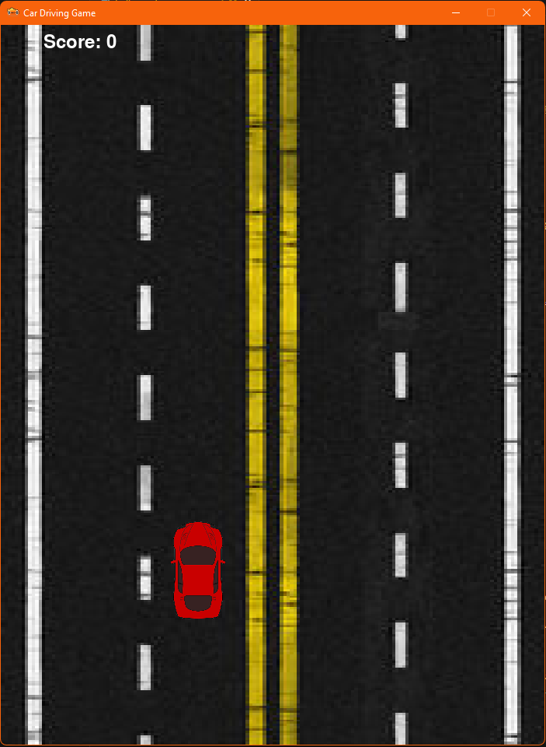
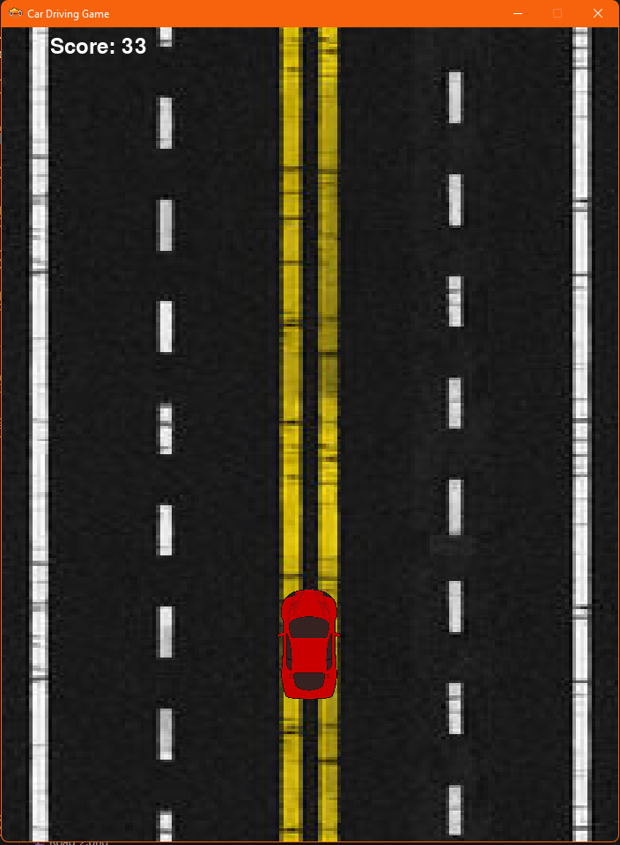
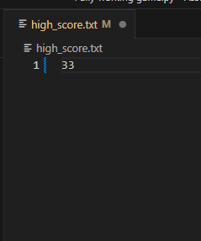
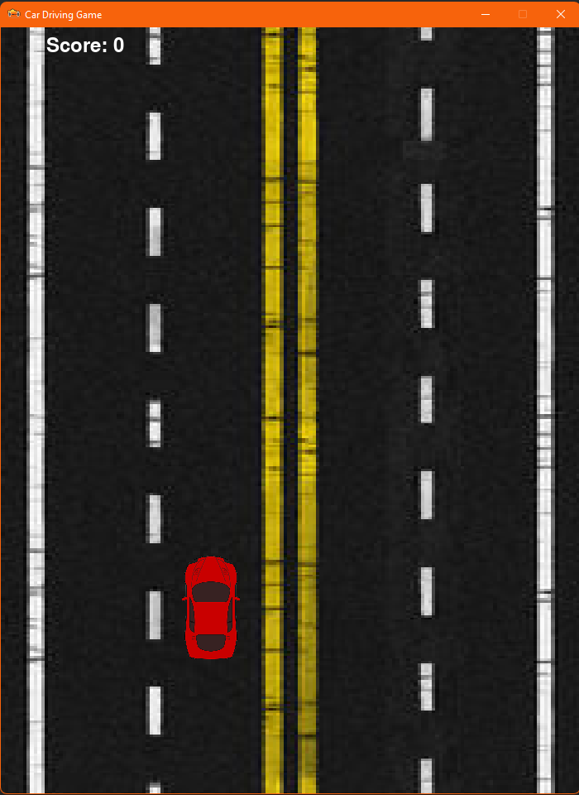
3.1 Assembled Outcome Testing – Usability Results
Dad:
1). Change the start car position
2). Update High Score when game closes
Brother:
3). No obstacles till player moves
1). Car now starts in the second lane direct in line with x_pos of oncoming traffic, This now forces the player to keep moving once the game has started instead of waiting in the middle the whole time. This is a good change, and I am happy with the result
3). Now, Obstacles will not spawn until the player makes a move. This is good change as will cause less frustration if a system takes longer to load. This fits in with my relevant implications.
2). The High Score now gets updated I even if the player does not get to the I end game screen for whatever reason I such as game crash or window forced closed. This is a good change and makes the game more usable for the player.
Notes:
Use this slide to provide a test plan for your complete program. You may wish to create multiple slides so that you can test for expected, boundary and unexpected cases.
Remember to test ALL logical pathways so that you can ensure your program works correctly.

Slide 44
3.2 Assembled Outcome Testing – Usability Updated
Having updated my code and made the suggested changes I asked the parties back to retry my code and see if they are happy with the updated design:
Dad:
He liked the changes made, He said, “the game now requires more skill and awareness” He said that my code now is more playable and user friendly.
Brother:
He liked my updated obstacle spawning requirements It means that the player does not have start moving until they are ready making the program more enjoyable and less prone to causing frustration.
Notes:
Use this slide to provide a test plan for your complete program. You may wish to create multiple slides so that you can test for expected, boundary and unexpected cases.
Remember to test ALL logical pathways so that you can ensure your program works correctly.

Slide 45
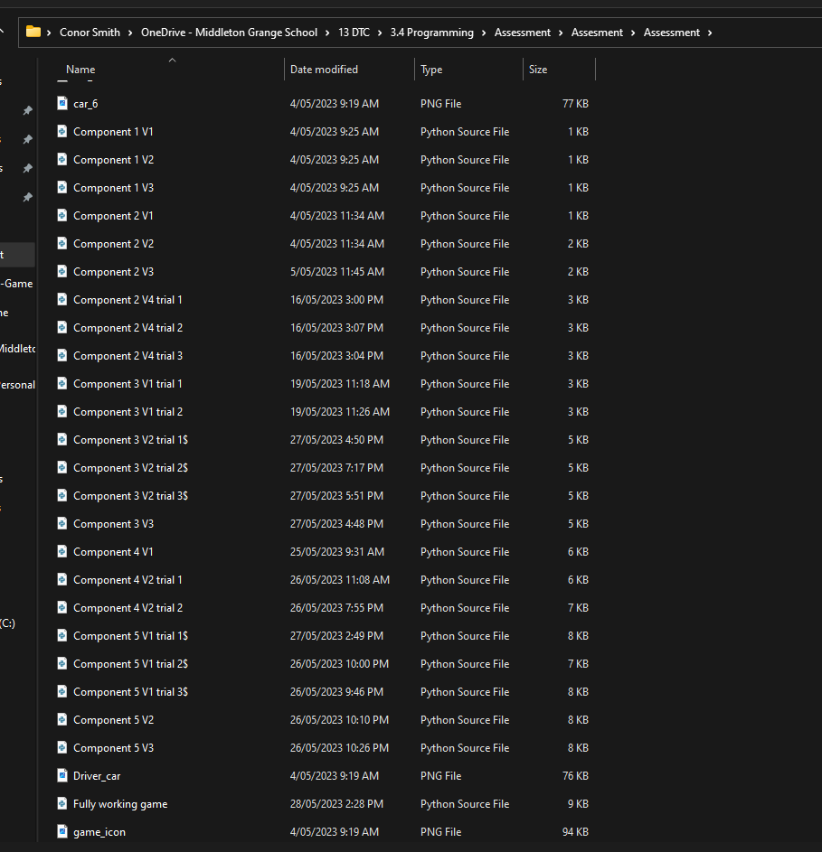
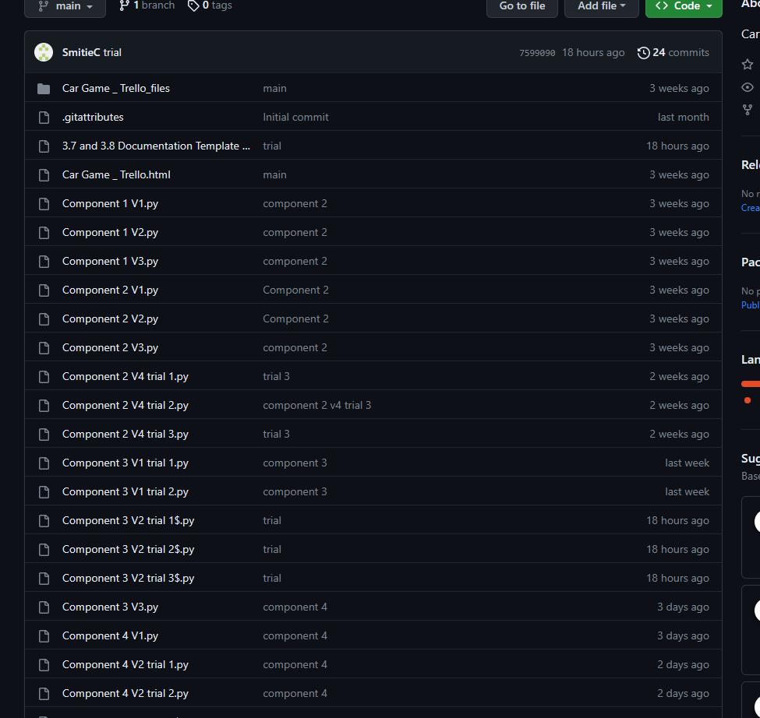
Version Control Evidence:
Notes:
Your version control evidence should go here. This could be in the form of screenshots (both of your GitHub repository as well as your local project folder) as evidence of your incremental development.

Slide 46
Complex processes - Discussion
Discuss how you used (and combined) information gained from the planning, testing and trialling of your components to improve the quality of your program. Note that synthesising information from planning, testing and trialling of components and then discussing how this led to a high quality outcome is needed for an E grade.
I used a Trello board to keep track of my project and ensure the components were developed in a logical way. Trello enabled me to be flexible with my planning, adding and moving cards and lists as new ideas were developed.
Trialling pieces of code and ensuring that a given component worked correctly made it easy to ensure that problems were resolved prior to combining with others. Once it had been thoroughly trialled and tested to prove that it worked properly, I had would then combine with other components to ensure they would work well with each other. This made the identification and fixing of problems much less complicated. This will also help if another programmer has to make changes and/or update my program. It is easy to follow my different versions as they are well commented and labelled.
I saved files on my local computer storage as well as using GitHub and Trello, but this meant I had a local set instead of always being on the cloud. The cloud is not always 100% available internet is sometimes not reliable and file syncing can sometimes play up. Having a set of local files meant I always had access to my program.
Notes:
Discuss how you used (and combined) information gained from the planning, testing and trialling of your components to improve the quality of your program. Note that synthesising information from planning, testing and trialling of components and then discussing how this led to a high quality outcome is needed for an E grade.

Slide 47
Complex processes - Discussion
I trialled all of my components finding the best way to implement them in the game. I would use the one that best made sense to use for this program. By doing this I would ensure that my game was high quality and efficient for the user. It would also mean another programmer would understand what my code is doing.
Per examples previous for each component, I ensured testing was done this meant the game I created was fun and enjoyable. I would not have been able to produce such a high-quality game without this level of testing.
Another way I collated information about how to further improve my program was the amount of other third-party user I got to test the program and provide any relevant feedback. Some if the feedback received was not of relevance to the project so I could not change and therefore have not been able to update. But for all feedback relating to the code and design of the game I was able to update and then once run past the user again they were happy with the result and gameplay. This meant that the game I produced was already tested to be of value to others not just me and would reach out to the intended audience.
Notes:
Discuss how you used (and combined) information gained from the planning, testing and trialling of your components to improve the quality of your program. Note that synthesising information from planning, testing and trialling of components and then discussing how this led to a high quality outcome is needed for an E grade.

